Slide 1
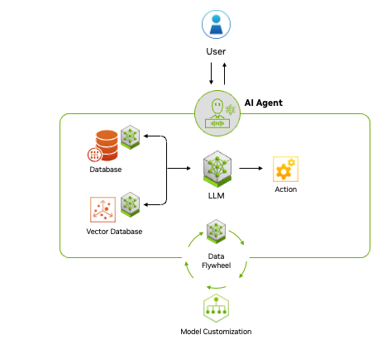
Module 2 - Agentic Tool Use & Action Logic
Goal: Moving from passive text generation to active environmental interaction.
Function Calling: Developing a library of Python tools (math, search, database) that agents can autonomously "choose" to execute.
Tool Discovery: Enabling agents to understand which tool fits a specific sub-task based on its description.

Slide 2
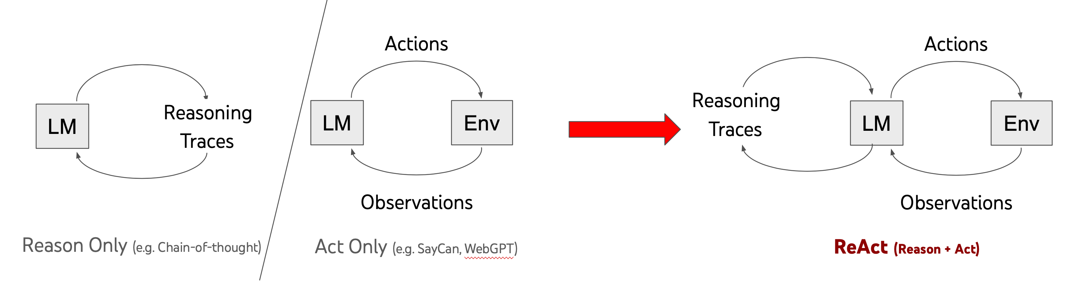
Reasoning Patterns (ReAct)
The Concept: Implementing the Reason + Act loop.
Logic: Forcing the LLM to "think" and document its reasoning before triggering a tool.
Example: "I need to check the local weather before I recommend an outfit"

Slide 3
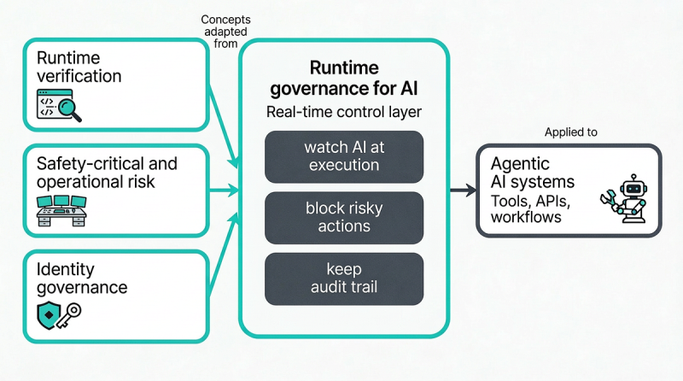
Governance & Safety
Human-in-the-Loop (HITL): Designing "Approval Nodes" where the system pauses for human confirmation before executing high-risk actions.
Safe Sandbox Execution: Running agent-generated code or terminal commands within isolated environments to prevent system damage.
Task 2 Deliverable: A script where the AI calls a custom Python function only when necessary.

